Slide 1
I just became team-lead ...
now what

Slide 2
Any team leads in the room?

Slide 3
Any team leads in the room?
Your mileage may vary

Slide 4
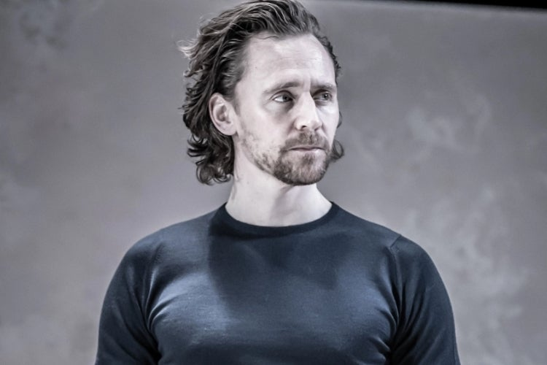
Frederick Vanbrabant
@maybeFrederick
www.frederickvanbrabant.com
Keyboard for hire

Slide 5


Slide 6
Management
Team lead
Senior developers
Medior developers
Junior developers

Slide 7
Management
Team lead
Senior developers
Medior developers
Junior developers

Slide 8
Management
Team lead
Senior developers
Medior developers
Junior developers

Slide 9
Management
Team lead
Senior developers
Medior developers
Junior developers
Notes:
Top of the hill baby
but you’re now no longer a developer. that’s no longer in your title

Slide 10
Management
Team leads
Senior developers
Medior developers
Junior developers
Notes:
Your now in a group with the other departments, not only the development

Slide 11
Your main job now is mostly supporting the development team
Notes:
you will now do a lot less of development
You might not realise this a first
But let’s look at what you will be doing

Slide 12
Time to start our first project!
Notes:
Time to make an impression!
Fix what was bothering you

Slide 13
About the Project
Social network that only communicates in cat gifs.
“Kind of like the uber of of cat communication.”
Budget: 100 000 EUR
TimeFrame: 2 Months

Slide 14
About the Project
Social network that only communicates in cat gifs.
“Kind of like the uber of of cat communication.”
Budget: 100 000 EUR (747 097 DKK)
TimeFrame: 2 Months
Notes:
100K !
2 months!
Twitter with cat giffs! wtf

Slide 15
Tech stack
Vue.js + Blade
Laravel backend + some Laravel CMS thing
MySQL
Docker
Notes:
As a good developer you go the dev route

Slide 16
Tech stack
headless front-end in React
Vue.js + Blade
Laravel backend + some Laravel CMS thing
MySQL
Docker
Notes:
Let’s make it headless. you’ve talked to the front-end dev and she would love to give react a try. Give her an open eco-system

Slide 17
Tech stack
headless front-end in React
Ports and adaptors DDD backend
Vue.js + Blade
Laravel backend + some Laravel CMS thing
MySQL
Docker
Notes:
Nice extendable backend. We have 3 months to make a CRUD system!

Slide 18
Tech stack
headless front-end in React
Ports and adaptors DDD backend
Vue.js + Blade
Laravel backend + some Laravel CMS thing
MySQL
Docker
PostgreSQL
Notes:
Oracle bad. + doctrine or Eloquent will just map it anyway

Slide 19
Tech stack
headless front-end in React
Ports and adaptors DDD backend
Vue.js + Blade
Laravel backend + some Laravel CMS thing
MySQL
Docker
PostgreSQL
Kubernetes!
Notes:
KUBERNETES!

Slide 20
Tech stack
headless front-end in React
Ports and adaptors DDD backend
Vue.js + Blade
Laravel backend + some Laravel CMS thing
MySQL
Docker
PostgreSQL
Notes:
On second thought, maybe not. Let’s not get overboard
Maybe next project

Slide 21
TEAM
2 Backend developers (Sr, Jr)
1 Frontend developer (mid)
Part time devops (if things go bad)
Notes:
That looks ok right?
The Jr can pick up some cool DDD stuff + code reviews
Front-end on her own, guess she will have to figure it out

Slide 22
Let’s count it out!
100K
Notes:
Time to make a roaming
Turns out that we charge 660 EUR a day for a senior dev. (5000 dkk)
5 days a week, 20 days a month that’s 13 200 EUR
Times 2 months: 26 400 EUR

Slide 23
* All prices are fictive
Let’s count it out!
Senior b-dev work: 26 400 EUR (197.217DKK)
73,6K
Notes:
Jr dev? 550 (4108 DKK)
1 month: 11000 EUR
Times 2 months: 22 000 EUR

Slide 24
* All prices are fictive
Let’s count it out!
Senior b-dev work: 26 400 EUR (197.217DKK)
Junior b-dev work: 22 000 EUR (164.334DKK)
51,6K
Notes:
mid front-end? 600 (4.481DKK)
1 month: 12000 EUR
Times 2 months: 24 000 EUR

Slide 25
* All prices are fictive
Let’s count it out!
Senior b-dev work: 26 400 EUR (197.217DKK)
Junior b-dev work: 22 000 EUR (164.334DKK)
Medior f-dev work: 24 000 EUR (179.328DKK)
29,6K
Notes:
devops? 600 (4.481 DKK)
Luckily we only needed him for 10 days
That makes 6000

Slide 26
* All prices are fictive
Let’s count it out!
Senior b-dev work: 26 400 EUR (197.217DKK)
Junior b-dev work: 22 000 EUR (164.334DKK)
Medior f-dev work: 24 000 EUR (179.328DKK)
Devops work: 6000 EUR (44.832DKK)
23,6K

Slide 27
Damn you are good at this stuff!
23 600 Eur (176.306 DKK) straight up profit!
Notes:
This looks great, let’s start the project

Slide 28
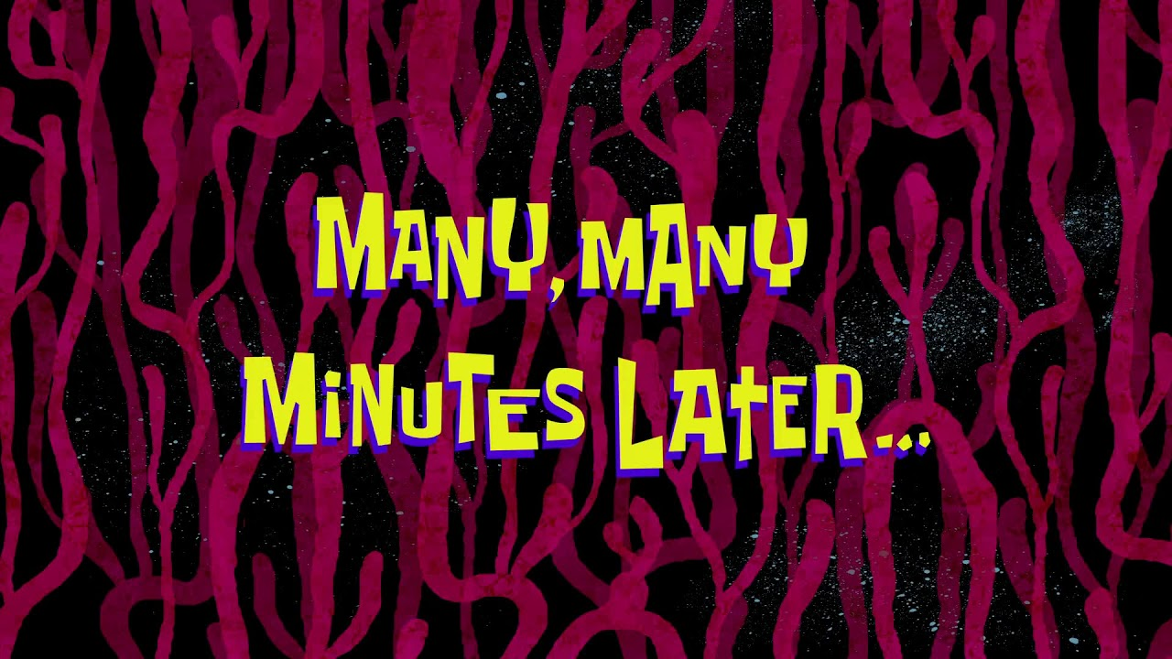
Notes:
You’re approaching the end of the project,
Let’s see how it’s going

Slide 29
How’s the project doing?
100K

Slide 30
* All prices are fictive
* This is very optimistic
How’s the project doing?
Senior b-dev work: 31 700 EUR (236.818 DKK)
68,3K
Notes:
Senior had to coach the junior into the DDD stuff
DDD stuff hard
Loads harder than just some off the shelve stuff
20%

Slide 31
* All prices are fictive
* This is very optimistic
How’s the project doing?
Senior b-dev work: 31 700 EUR (236.818 DKK)
Junior b-dev work: 26 400 EUR (197.217 DKK)
41,9K
Notes:
Junior is super good
But still wtf DDD It’s ok we have the buffer
20%

Slide 32
* All prices are fictive
* This is very optimistic
How’s the project doing?
Senior b-dev work: 31 700 EUR (236.818 DKK)
Junior b-dev work: 26 400 EUR (197.217 DKK)
Medior f-dev work: 19 200 EUR (143.464 DKK)
22,7K
Notes:
The front-end dev really liked working this way
10% less work!
What a win!

Slide 33
* All prices are fictive
* This is very optimistic
How’s the project doing?
Senior b-dev work: 31 700 EUR (236.818 DKK)
Junior b-dev work: 26 400 EUR (197.217 DKK)
Medior f-dev work: 19 200 EUR (143.464 DKK)
Devops work: 6000 EUR (44.832 DKK)
16,7K
Notes:
Devops, nothing changed. He’s cool like that
You’re really glad we didn’t go for kubernetes at this point

Slide 34
Damn you are good at this stuff!
23 600 Eur (176.306 DKK) straight up profit!

Slide 35
Ok-ish
Damn you are good at this stuff!
23 600 Eur straight up profit!
16 700 (124.756)
Notes:
Ok not all that great.
We still made a profit, but we learn right?

Slide 36
Ok-ish
Damn you are good at this stuff!
23 600 Eur straight up profit!
16 700 (124.756)
Notes:
We still have to pay wages
Maybe a small profit here

Slide 37
Notes:
Time to share some experiences with you new team
Pm: I remember my first project, went way over budget
wait what?

Slide 38
Design
Marketing
Project Manager
Devops
Development
Notes:
Then It starts to dawn on you ...

Slide 39
Design
Marketing
Project Manager
Devops
Development
5 % budget
5 % budget
20 % budget
5 % budget
65 % budget
Notes:
Then It starts to dawn on you ...

Slide 40
* All prices are fictive
* This is very optimistic
How’s the project doing?
Senior b-dev work: 31 700 EUR
Junior b-dev work: 26 400 EUR
Medior f-dev work: 19 200 EUR
Devops work: 6000 EUR
16,7K

Slide 41
* All prices are fictive
How’s the project doing?
Senior b-dev work: 31 700 EUR
Junior b-dev work: 26 400 EUR
Medior f-dev work: 19 200 EUR
Devops work: 6000 EUR
-18,3K
Notes:
whoops

Slide 42
01
02
03
04
What to take away from this story

Slide 43
01
02
03
04
Software is expensive
What to take away from this story

Slide 44
01
02
03
04
Software is expensive
What to take away from this story
Quality costs money

Slide 45
01
02
03
04
Software is expensive
What to take away from this story
Quality costs money
You are not an island

Slide 46
01
02
03
04
Software is expensive
What to take away from this story
Quality costs money
You are not an island
Communication could have solved all of this

Slide 47
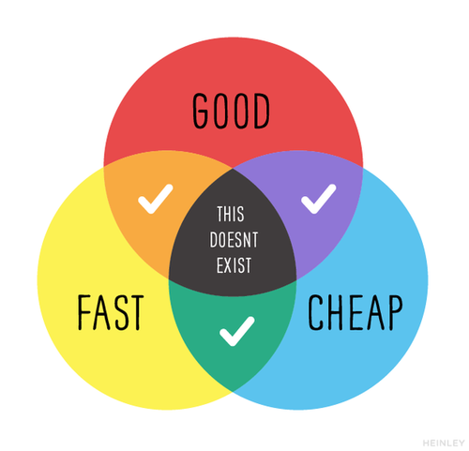
Notes:
You know this one right.
We as devs are always very smug about it.
Reality is that most clients aren’t really that concerned about GOOD. Devs don’t realise that
Otherwise every project would have tests, event storming, ...

Slide 48
Keeping the team motivated
Notes:
On the topic of communication

Slide 49
Trust
Honesty
Context
Notes:
I felt very silly making this slide
but I can’t communicate it better

Slide 50
Trust
Your team is full of intelligent people
You can’t do everything yourself
Ownership blooms quality
Notes:
Team intelligent: they are hired with a reason, highly educated
Letting go: You will have a lot on your plate, delegate
Ownership: Scrum stuff, give them a baby to nurture

Slide 51
Honesty
Office politics kills motivation
Admit when you’re wrong
You get back what you put in
Notes:
You are not machiavelli. An office is not a roman senate, you’re a team
You don’t have to prove your smarts, people will no longer come with ideas
This is what you really want. This gives things to handle upon

Slide 52
Context
Why are we doing things
Get feedback
People will know constraints
Notes:
This is again part of ownership. Bigger picture
You aren’t perfect, again very smart people
People will know how to behave in a project

Slide 53
This isn’t only about software
Notes:
The previous points aren’t about tickets and issues
Company wide
Where are we going, why are doing things we are doing, help us
Last year we went teambuilding in Dubai, this year it’s 2 villages over. Is the company in trouble? no the booking fell through

Slide 54
Trust
Honesty
Context
Could you follow this up?
We kinda forgot about this part of the project, and it’s vital to the client because a future payment module depends on it.

Slide 55
Talking to clients
Notes:
This is also part of your job now
I’m going to go a bit quicker over this, cause we also need to check the hiring stuff

Slide 56
01
02
03
Talking to clients:
The Survival guide

Slide 57
01
02
03
Listen to them
Talking to clients:
The Survival guide
Notes:
They are asking advice here. But don’t over do it
It’s their project

Slide 58
01
02
03
Listen to them
Talking to clients:
The Survival guide
Don’t promise extra
Notes:
if you promised it, you’re going to have to build it.
If it’s not scoped, it’s free

Slide 59
01
02
03
Listen to them
Talking to clients:
The Survival guide
Don’t promise extra
Write it down, and mail it
Notes:
Make sure everyone is on the same page
Paper trail

Slide 60
Also the Trust, Honesty and Context stuff
Notes:
Don’t try and sell stuff they don’t need (reputation)
Legacy project, might burn people out
Tell them why you want to do it a certain way

Slide 61
Hiring
Notes:
Fun times
A lot of people want to be in this seat, isn’t all that great
Could be a talk on it’s own

Slide 62
Why are brain teasers still a thing?
Notes:
Every developer hates them. So why?

Slide 63
Why are brain teasers still a thing?
It’s a safety net
Notes:
A lot of people don’t know how to code ....
Some people are very good at selling themselfs
You can learn a lot from a FizzBuzz exercize

Slide 64
What are my options here?

Slide 65
FizzBuzz
Notes:
Explain fizzbuzz
3: fizz
5 buzz
3 and 5L fizz buzz

Slide 66
for ($i = 1; $i <= 100; $i++)
{
if ($i % 3 === 0 && $i % 5 === 0){
echo "FizzBuzz<br />";
}
else if ($i % 3 === 0){
echo "Fizz<br />";
}
else if ($i % 5 === 0){
echo "Buzz<br />";
}
else {
echo $i . "<br />";
}
}

Slide 67
Very smart questions to see how the candidate thinks
Notes:
To see how the candidate reasons
Tell us your thought process

Slide 68
How many golf balls are there in New York
Notes:
tons of different languages

Slide 69
Gilded Rose
Notes:
big ugly class
tests are there
refactor

Slide 70
https://github.com/emilybache/GildedRose-Refactoring-Kata
Notes:
tons of different languages

Slide 71
Show us some open-source work
Notes:
This is simple right

Slide 72
Create a PR to some open-source work
Notes:
This is simple right

Slide 73
Talk to them like a human being
Notes:
Controversial one

Slide 75
FizzBuzz
You learn that they can do the basics

Slide 76
FizzBuzz
You learn that they can do the basics
How many golf balls in New York
You look really smart

Slide 77
FizzBuzz
You learn that they can do the basics
How many golf balls in New York
You look really smart
Gilded Rose
Refactoring is important

Slide 78
FizzBuzz
You learn that they can do the basics
How many golf balls in New York
You look really smart
Gilded Rose
Refactoring is important
Show open-source work
What if they don’t have any?

Slide 79
FizzBuzz
You learn that they can do the basics
How many golf balls in New York
You look really smart
Gilded Rose
Refactoring is important
Show open-source work
What if they don’t have any?
Make a PR to open source
Gives insight into PR’s and what projects they like

Slide 80
FizzBuzz
You learn that they can do the basics
How many golf balls in New York
You look really smart
Gilded Rose
Refactoring is important
Show open-source work
What if they don’t have any?
Make a PR to open source
Gives insight into PR’s and what projects they like
Have an actual conversation
See what moves people. blog posts, how they think about a company and processes

Slide 81
Trust
Honesty
Context
Notes:
And remmber this

Slide 82
THANKS!
@maybeFrederick

Slide 83
Questions!
@maybeFrederick

Slide 84
Credits
This is where you give credit to the ones who are part of this project.
Did you like the resources on this template? Get them for free at our other websites.
Presentation template by Slidesgo
Icons by Flaticon
Infographics by Freepik
Images created by Freepik
Author introduction slide photo created by Freepik
Text & Image slide photo created by Freepik.com

